Slide 1
Thermodynamics for Cryogenics with the emphasis here on large-scale helium cryogenics
Tom Peterson, SLAC
January 2017

Slide 2
Outline
Definitions
Perfect gas (Pv=RT)
Equations of state
Entropy
Compression and expansion processes
Liquid/vapor systems

Slide 3
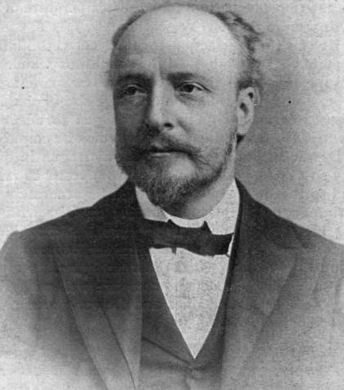
Old science with modern applications
Thermodynamics is the study of macroscopic energy transformations between heat and work
Thermodynamics has its basis in attempts to understand combustion and steam power (much in the 19th century) but is still “state of the art” in terms of practical engineering issues for cryogenics
James Dewar (invented vacuum flask in 1892)

Slide 4
Focus of this lecture
Thermodynamics is a large area of study, far too much to cover in this one-hour introduction
I will focus on the thermodynamics concepts which I have found most important in my experience designing cryogenic systems and cryostats

Slide 5
The laws of thermodynamics
First law – “The energy of the isolated system is conserved.” (Conservation of energy)
Second law – “The entropy of the isolated system increases in all real processes and is conserved in reversible (theoretical) processes.”
Third law – “The entropy of a pure substance in complete thermodynamic equilibrium becomes zero at a temperature of absolute zero.” (One can never reach absolute zero.)

Slide 6
Some thermodynamics definitions
A “system” in thermodynamics is a specified region in which mass transfer and/or heat transfer is studied
  A “boundary” separates the system from its “surroundings”
  Proper definition of the system can be important in solving a problem (we’ll see that in some examples later)

Slide 7
More definitions
An “isolated” system has no mass or energy crossing the boundary
A “closed” system has no mass crossing the boundary
An “open” system has mass crossing the boundary and may or may not have constant mass
The thermodynamic “state” of the system is the condition at a moment in time as defined by the system properties
In general, two properties define the state of a system consisting of a pure substance in equilibrium

Slide 8
Commonly used properties
T – temperature
P – pressure (force per unit area)
v – specific volume (volume V per unit mass)
U – internal energy of the closed system or
u – internal energy per unit mass
H – enthalpy = U + PV
h – enthalpy per unit mass (specific enthalpy)
S – entropy
s – entropy per unit mass

Slide 9
Derived properties, C_{v} , C_{p} , k
Some important thermodynamic properties are defined from others, such as the heat capacities, c_{v} , and c_{P} , and k
Since typically two properties define the state of the pure fluid in thermodynamics, equations generally have two independent variables
Derivatives then are partial derivatives with respect to one independent variable with the other held constant

Slide 10
Perfect gas approximation
A perfect gas obeys the equation Pv=RT where R is a constant called the gas constant
The internal energy of a perfect gas is a function of temperature alone, where c_{v} is constant
Since h = u +Pv, so h = u + RT for a perfect gas, enthalpy is also a function of temperature alone for a perfect gas, where c_{p} is constant.

Slide 11
Pv/RT versus P for helium
Pv/RT
300 K
20 K
Pressure (atm)

Slide 12
Equations of State
In many cases, Pv=RT may be a good approximation
  For example, far enough from the critical pressure and from the condensation temperature
  Good to within 10% for helium down to 8 K
Terms may be added to account for deviations from Pv=RT, such as
This is called the “virial equation”, and the coefficients B, C, etc. are called “virial coefficients”.
Equations of state enable calculation of fluid properties based on measurements of some of the basic properties

Slide 13
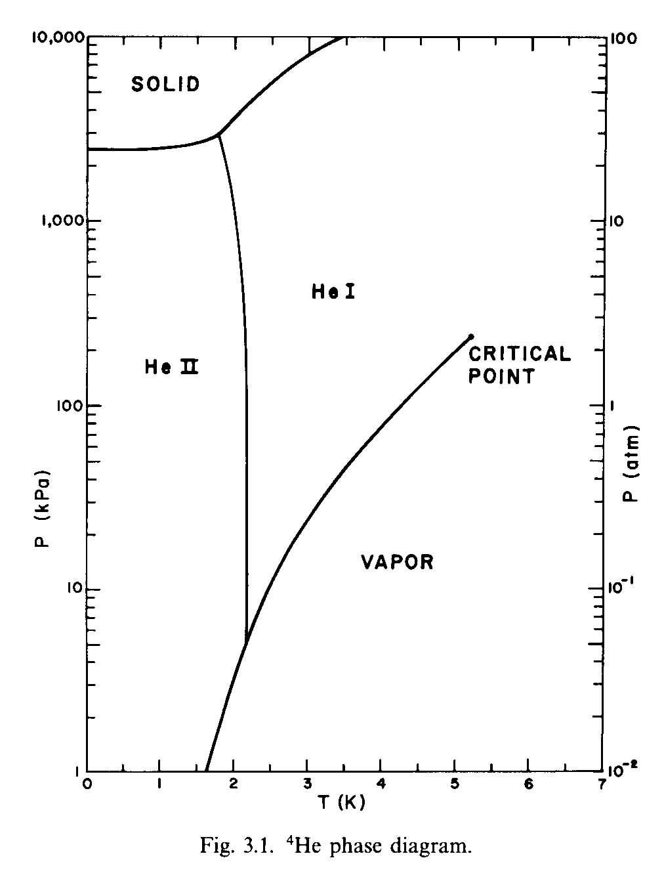
Helium phase diagram
(Steven W. VanSciver, Helium Cryogenics, p. 54)
Critical point is 5.2 K, 2.245 atm
Lambda transition from helum I to helium II is 2.172 K

Slide 14
From Obert,
Concepts of
Thermodynamics

Slide 15
Entropy
Least intuitive of the common properties
Definition of entropy is based on energy change in a perfect, loss-free (reversible) process
Entropy is the property which is held constant in a adiabatic (no heat flow in or out) reversible process like the perfect closed piston compression and expansion

Slide 16
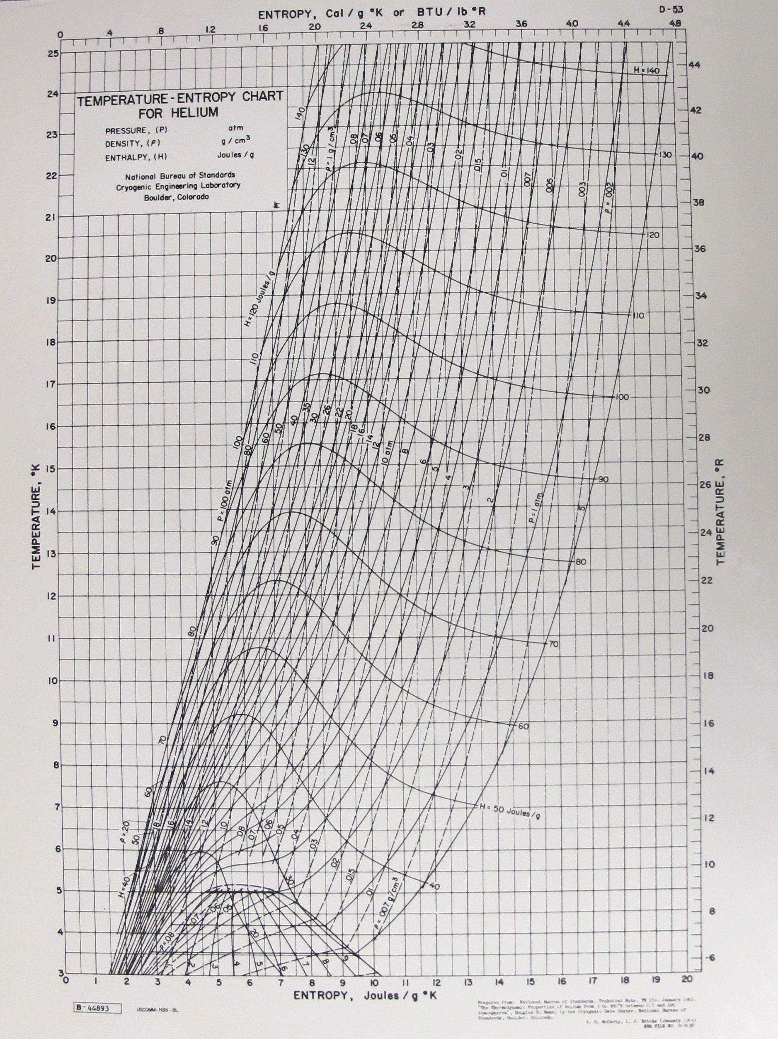
T-s diagram for helium

Slide 17
The TdS equations
From the first law (energy conservation) for a closed system with reversible addition or removal of heat and mechanical work (pdV), we have:
With we have the first TdS equation:
From
Which gives us the second TdS equation:

Slide 18
Isothermal compression
Example application of TdS equation
From the second TdS equation,
with constant temperature (isothermal) compression of an ideal gas, dH = 0, so
For the ideal gas,
substituting gives
and integrating,

Slide 19
Isothermal compression
Isothermal compression “squeezes” the entropy out of the helium by increasing pressure at constant temperature
Enthalpy h (function of T alone) remains constant
Yet energy (heat) is removed in isothermal compression
That energy is and is equal to the compressor work, which we saw is

Slide 20
Isothermal compression example
The second stage screw compressor at Fermilab’s MTF compresses 200 grams/sec helium from about 2.6 bar to 15 bar
For helium R = 2.078 J/gK, so the ideal work at 300 K would be
With typical power consumption of 800 HP = 600 kW, the isothermal efficiency is about 37%

Slide 21
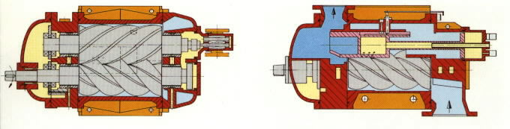
A real helium compressor
Oil-flooded screw compressors are now standard
A typical pressure ratio is about 4:1, so two stages are used in a typical helium plant to get a 15:1 to 20 :1 pressure ratio

Slide 22
Isentropic expansion
Removes energy from the system at constant entropy by means of adiabatic (no heat transfer) reversible (loss-free) work
Expansion at constant entropy from about 70,000 atm and room temperature to 1 atm would remove enthalpy (as work) to that of 2-phase helium

Slide 23
Isentropic efficiency
Isentropic expansion efficiency is defined as
where Δh = h_{in} – h_{out}
Δh_{real} will always be less than Δh_{isentropc} so efficiency will be less than 100%
For real expanders, 65% to 85%

Slide 24
Ideal helium process

Slide 25
Isothermal heat absorption
Net ideal work (energy per unit mass of working fluid) into the system is T_{amb}Δs- Δh
For a refrigerator with the heat load absorbed by evaporation at constant liquid temperature, T_{liq}, Δh = T_{liq} Δs
Thus, the ratio of applied work to heat absorbed is (T_{amb} Δs- Δh)/ Δh = T_{amb}/T_{liq}-1
For low temperatures this is approximately the ratio of absolute temperatures, T_{amb}/T_{l}

Slide 26

Power required for a non-isothermal load
Use
Where P is the ideal room-temperature power required to remove a non-isothermal heat load
I will show the use of this later in calculating cryogenic system power

Slide 27
Exergy
In many cryogenics analyses, authors describe an “exergy” analysis
  Exergy is defined as de = dh – T₀ds, which is the quantity described previously as the ideal refrigeration power
  At each stage, one can compare the real power required with expected, from

Slide 28
Gibbs Free Energy
In thermodynamics texts, you will find the quantity Gibbs Free Energy defined, which is G = H – TS
For processes which start and end at the same temperature, one may compare the real process with an ideal cycle rejecting heat to that reference temperature, T₀. On a per unit mass basis, dg = dh – T₀ds
So exergy (the ideal work for refrigeration) is basically the same concept in reverse as Gibbs Free Energy, the maximum work that can be extracted from a process doing work

Slide 29
Example cryo power analysis
See ILCcryoTDP-26June2012.xls

Slide 30
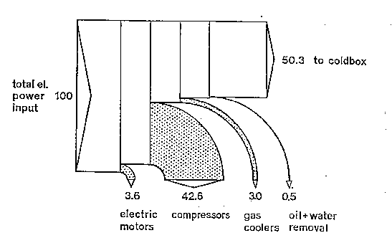
Cryogenic plant losses (compressor) from B. Ziegler, “Second Law Analysis of the Helium Refrigerators for the HERA Proton Magnet Ring,” in Advances in Cryogenic Engineering,
Vol. 31, Plenum Press, 1986, p. 693

Slide 31
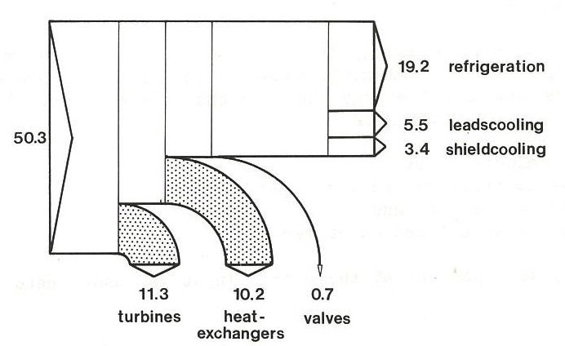
Cryogenic plant losses (cold box) from B. Ziegler, “Second Law Analysis of the Helium Refrigerators for the HERA Proton Magnet Ring,” in Advances in Cryogenic Engineering,
Vol. 31, Plenum Press, 1986, p. 693

Slide 32
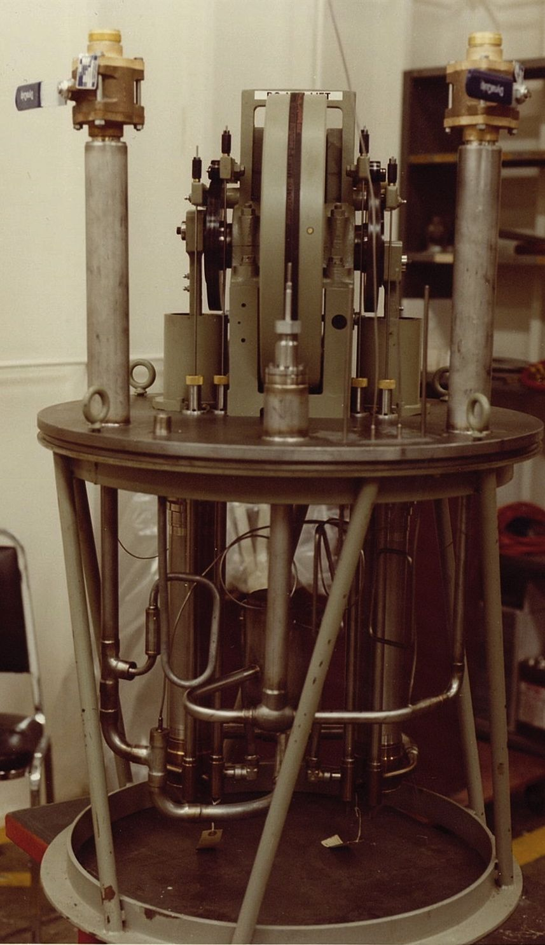
Expansion engines
Reciprocating expansion engines are used in many small liquefiers and help to illustrate some fundamentals of thermodynamics
At the right is a Koch Process Systems (similar to “model 1400”) expander with cryostat open

Slide 33
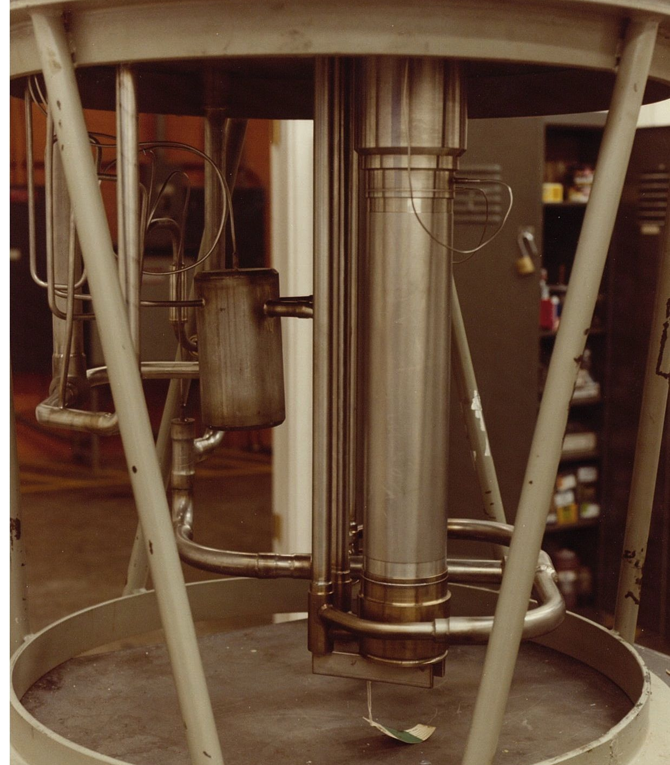
Expansion engine cylinder
At the right is a close-up of the expander showing the cylinder, valve bodies, and some of the cryogenic piping

Slide 34
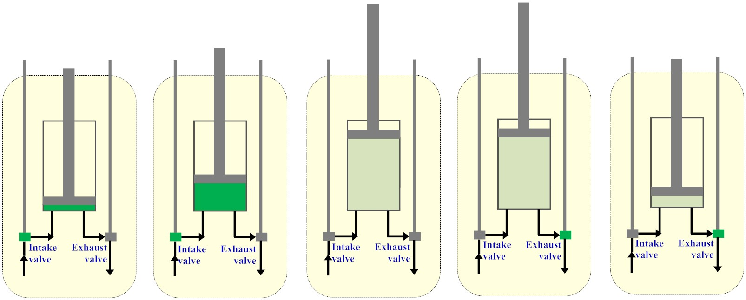
Expansion engine cycle
Work extraction
Work extraction
1
2
3
4
5
Minimal volume,
intake valve
opens
Filling cylinder,
then intake
valve closes
Valves closed,
constant mass
expansion
Maximal volume,
exhaust valve
opens
Cut-off volume,
exhaust valve
closes

Slide 35
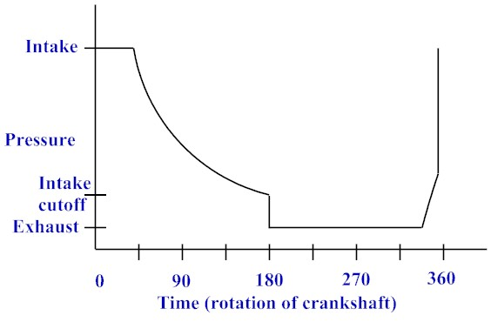
Pressure trace
2
3
1
4
5

Slide 36
Efficiency discussion
Intake cutoff, incomplete expansion
  Leaves some pressure unutilized
  Allows larger mass flow (intake valve open longer, more mass into cylinder each stroke)
Intake and discharge valve leakage
Heat conduction into expander
Heat transfer to and from cylinder walls and piston head
Dead volume leaves cooled helium behind which mixes with intake

Slide 37
Helium expansion example

Slide 38
Isenthalpic expansion
Expansion through a valve does no work, and neither adds nor removes energy
  Process is isenthalpic
Enthalpy of the perfect gas is a function of temperature alone
  Isenthalpic process of perfect gas
  does not change the temperature
Real fluids may change temperature via an isenthalpic expansion
  Joule-Thomson effect

Slide 39
Joule-Thomson expansion
In many real fluids, including helium near the liquid-vapor dome (see T-s diagram), isenthalpic expansion may provide temperature drop
  Not as efficient of isentropic expansion
  But very convenient and easy (no moving parts)
Joule-Thomson expansion through a valve is said to be through a “J-T valve”

Slide 40
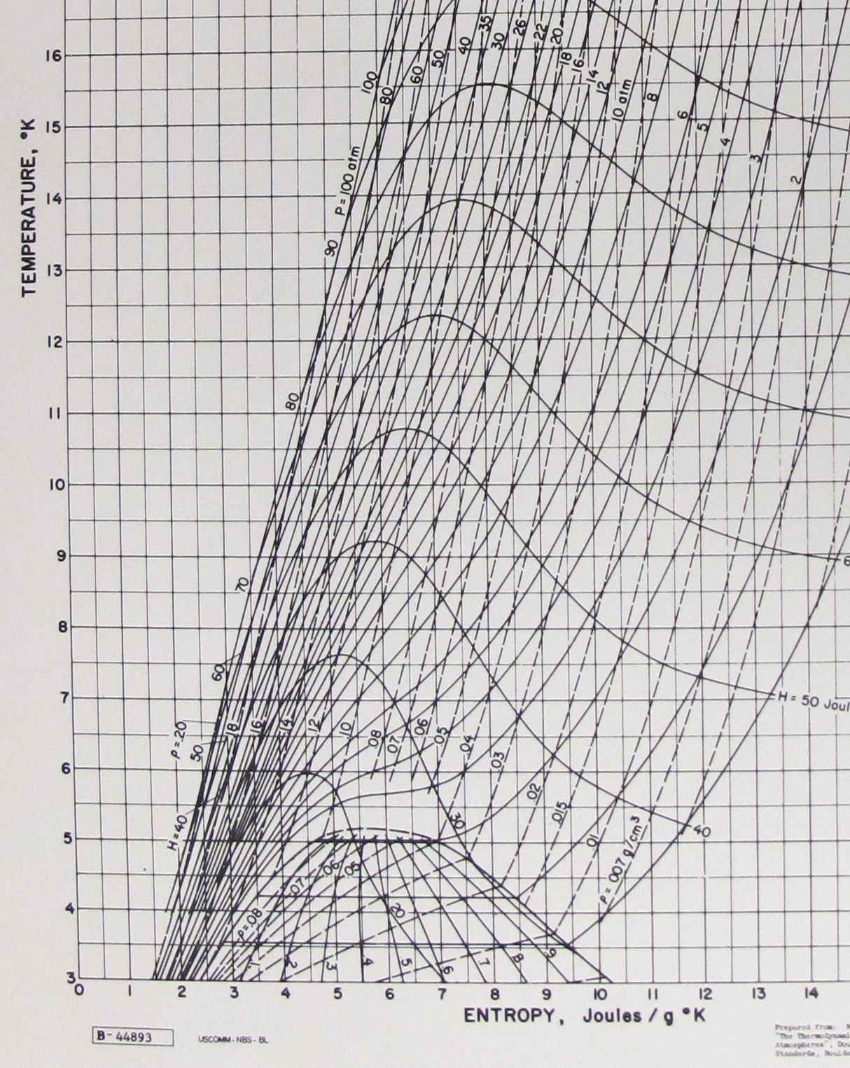
T-s diagram for helium (closer look)

Slide 41
Helium JT inversion curve
Note that lines of constant enthalpy are not horizontal (not constant temperature) on the previous T-s diagram.
Movement along a line of constant enthalpy with a pressure change (isenthalpic expansion or compression) may result in a temperature increase or decrease.
The curve demarking where and where
is called the “Joule-Thomson inversion curve”.

Slide 42
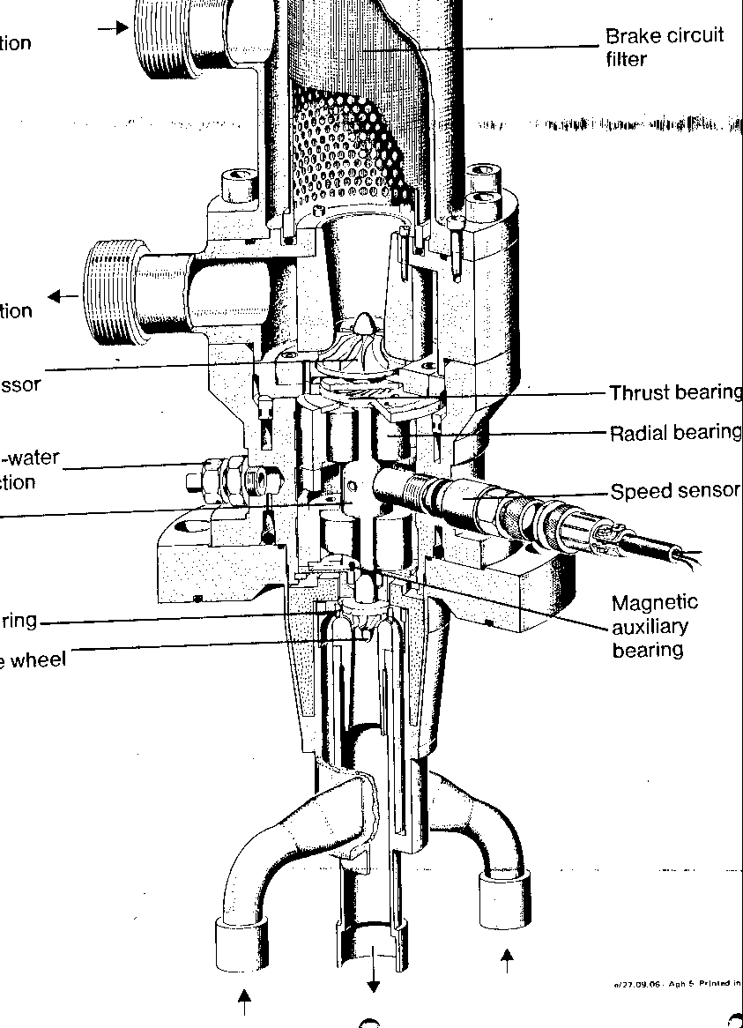
Turboexpander
Linde turbine at right
Expansion turbines are typically used in helium refrigerators larger than about 500 W.
Real efficiencies (relative to isentropic) are 60% to 80%

Slide 43
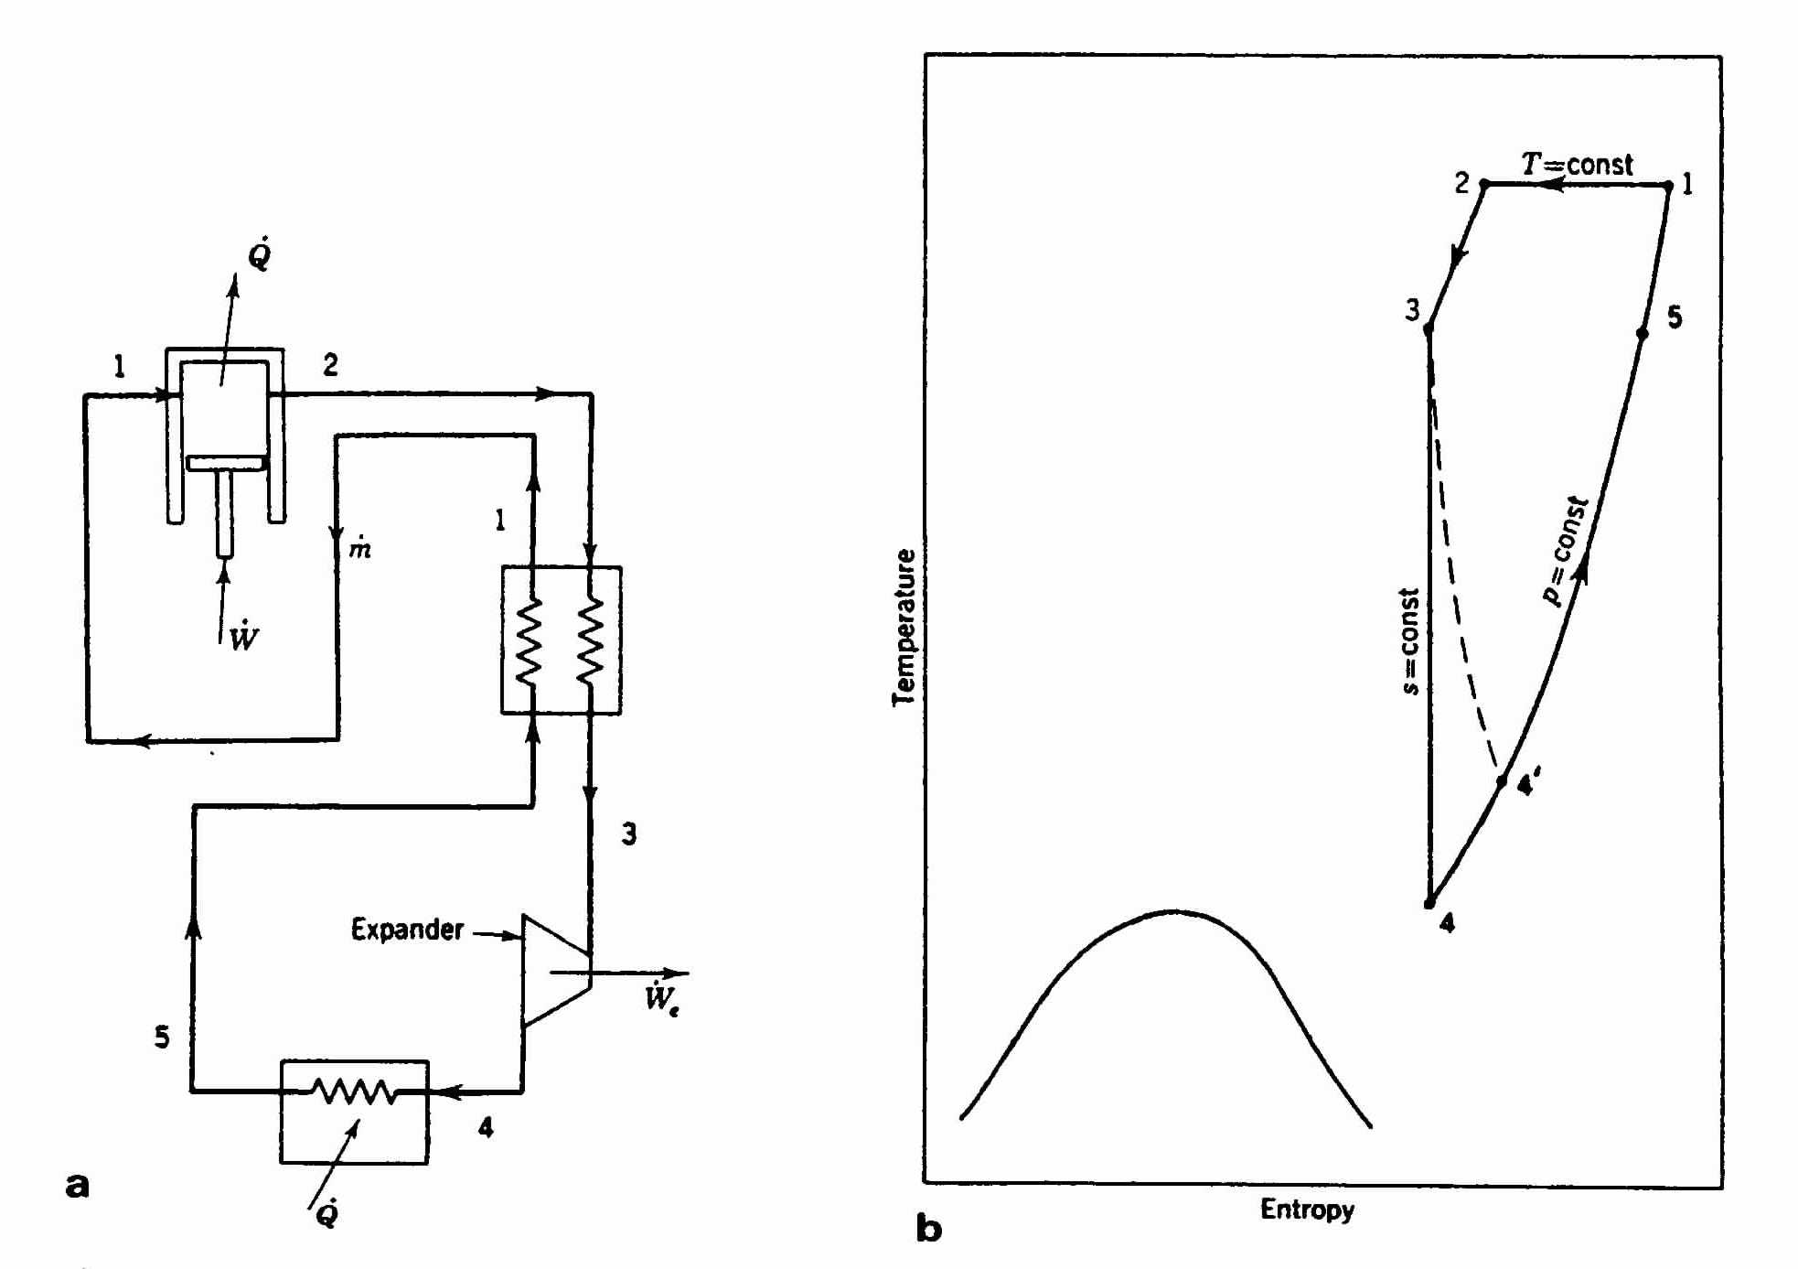
A simplified real helium cycle
Klaus D. Timmerhaus and Thomas M. Flynn,
Cryogenic Process Engineering, p.126

Slide 44
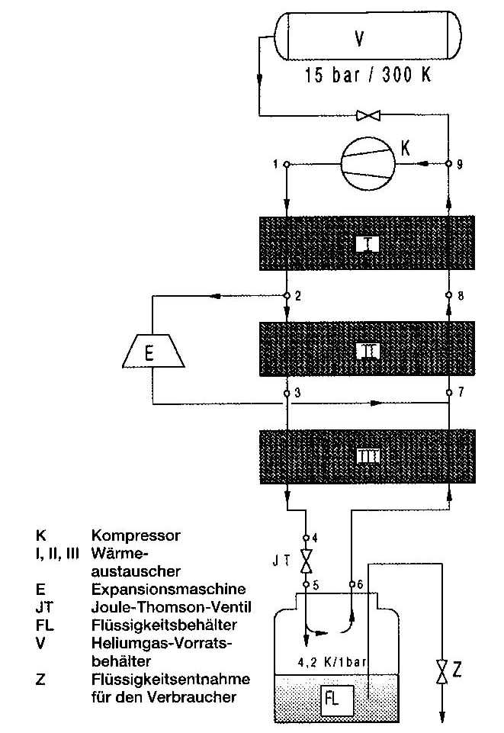
A more typical modern helium cycle
(but still simplified, from Linde Kryotechnik, AG)
The “Claude process”, shown to the right, includes intermediate temperature expanders
Modern cryoplants follow this pattern
The HERA plants each have 7 turboexpanders

Slide 45
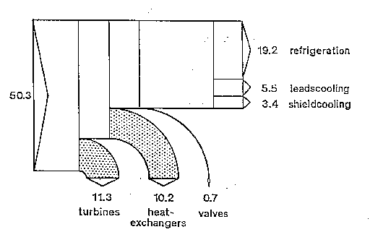
Cold box losses from B. Ziegler, “Second Law Analysis of the Helium Refrigerators for the HERA Proton Magnet Ring,” in Advances in Cryogenic Engineering,
Vol. 31, Plenum Press, 1986, p. 693

Slide 46
Helium cycle efficiency

Slide 47
References
Edward F. Obert, Concepts of Thermodynamics, McGraw-Hill, Inc., 1960.
R. Byron Bird, Warren E. Stewart, Edwin N. Lightfoot, Transport Phenomena, John Wiley &Sons, 1960.
S. W. VanSciver, Helium Cryogenics, Plenum Press, 1986.
Mooney, David A., Mechanical Engineering Thermodynamics, Prentice-Hall, Inc., New York, 1953.

Slide 48
Question for discussion tomorrow
“Square wave engine”

Slide 49
Square wave engine illustrates an interesting thermodynamics problem
“Square wave” engine problem
  Suppose intake valve is open for entire 180 degree intake stroke
  No closed-cylinder expansion
  Intake valve closes, then exhaust valve opens, so cylinder contents blow down from intake pressure to discharge pressure

Slide 50
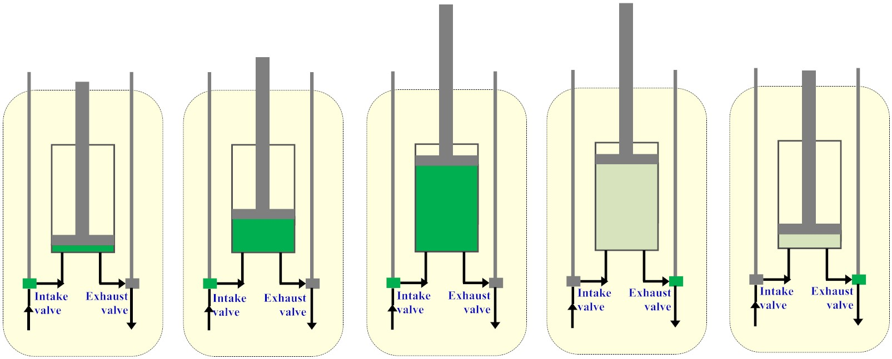
Intake valve open 180 degrees
Fill cylinder with intake valve open, then open exhaust valve

Slide 51
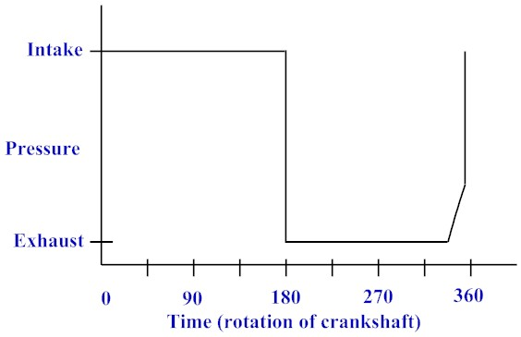
Square wave pressure trace

Slide 52
Square wave problem
Entire intake stroke at higher pressure than entire discharge stroke
Engine clearly does work, generates power
But no isentropic expansion
  No closed-cylinder expansion of any kind
Where does power come from? What gas properties change, and how? We’ll discuss that tomorrow.

